Slide 1
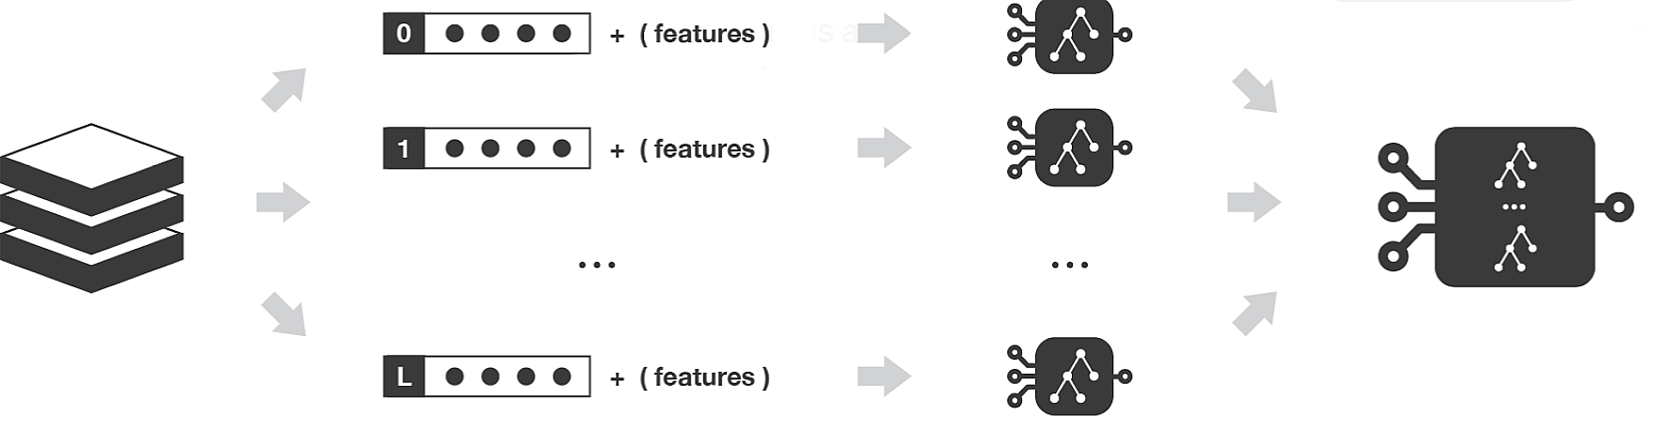
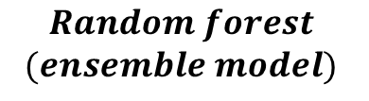

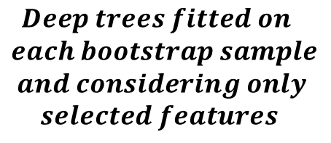





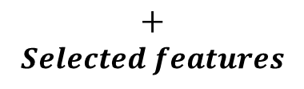
$$1$$
$+ (features)$
$$2$$
$+ (features)$
$$M$$
$+ (features)$
$$Initial dataset M bootstrap datasets$$
$$Deep trees fitted on$$
$$each bootstrap sample$$
$$and considering only$$
$$selected features$$
$$Random forest$$
$$(ensemble model)$$
$+$
$$Selected features$$

